Slide 1
WAD2 Group Project
Team 10-D

Slide 2
Project Overview
Users will be able to view albums
Authenticated users will be able to like/dislike, comment on and upload albums
The home page will show top rated albums, albums uploaded that day, and a search feature for users/albums
A “follow” system- users will be able to follow other users, and albums they rate will show in the home page

Slide 3
Project Specification
Use of cookies, to keep track of views

Slide 4
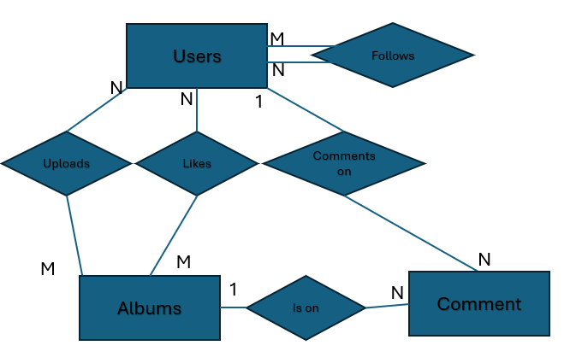
ER diagram
Users
Albums
Fields | Type
Username | Char(20)
DateCreated | Date
Fields | Type
Title | Char(40)
Likes | Integer
Dislikes | Integer
Followers | Integer
CoverArt | Image
UploaderUsername | Char(20)
UploadDate | Date
Views | Integer
1
Comments
Fields | Type
Text | Char(128)
Username | Char(20)
AlbumTitle | Char(40)

